Slide 1

CENTER FOR ADVANCE STUDIES DR. A.P.J. ABDUL KALAM TECHNICAL UNIVERSITY, LUCKNOW
Presentation
On
WANNACRY
PRATISHTHA SAXENA
M.TECH(CS-CYS)

Slide 2

Interesting Facts about the “WannaCry” Ransomware Attack

Slide 3
Figures
The attack started on Friday, 12 May 2017
Infected more than 230,000 computers
Asks for ransom payments in the cryptocurrency Bitcoin in 28 languages
Over 150 countries around the world have been affected
Asks for a payment of around $300 in bitcoin within three days or $600 within seven days

Slide 4
How does it infect computers?
Via Phishing e-mails
Users receive an email with a file, usually in a .zip format. When the user clicks on the file or opens it, the virus automatically spreads and lock up files and programs.
Once the computer is fully infected, the user can access only two files - instructions on what to do next and the virus program itself.

Slide 5
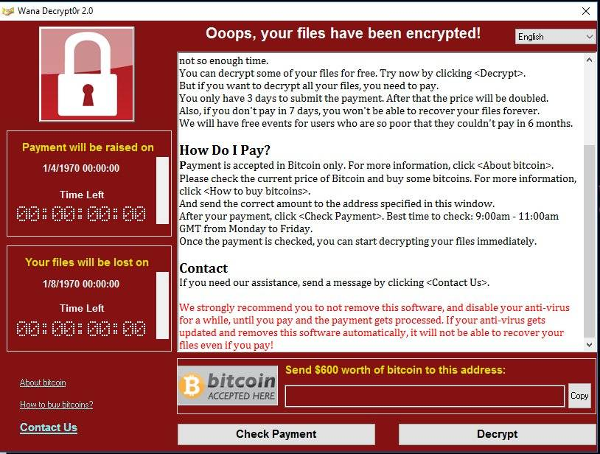
Message Displayed

Slide 6
Majorly Targeted Countries
Germany
India
Spain
Russia
Romania
Italy
South Korea

Slide 7
Affected Companies Worldwide
Britain’s National Health System (NHS) was amongst the biggest victims.
Nissan Motors
China National Petroleum
Renault SA
The Yancheng police department in China
The Russian Interior Ministry and many more…

Slide 8
Defending against WannaCry
DO NOT open or click on fishy emails
DO NOT click on suspicious links and files
UPDATE the latest security patches of your OS
INSTALL an internet security software on our computer & mobile phones
IMPLEMENT reliable data backup techniques for easy data recovery

Slide 9
THANK YOU

